Slide 1
S-2
1)Ambiguity in CFG
2) Example of Ambiguous grammar
3) Removing Ambiguity(Ambiguous → Unambiguous grammar)

Slide 2
Ambiguous grammar

Slide 3
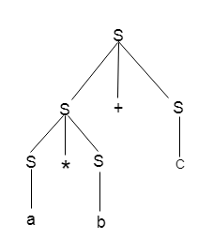
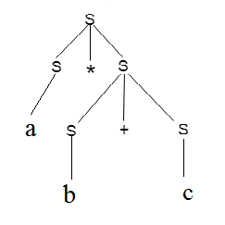
Ambiguity
Example1: Input String : W=a * b + c
Parse Tree for Left most Derivation Parse Tree for Right most Derivation
A grammar is said to be ambiguous if there exists more than one leftmost derivation or more than one rightmost derivative or more than one parse tree for the given input string.

Slide 4
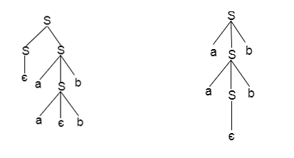
Contd…
Example 2 :
S = aSb | SS
S = ∈
Parse Tree I Parse Tree II

Slide 5
Contd…
If the grammar has ambiguity then it is not good for a compiler construction.
No method can automatically detect and remove the ambiguity but you can remove ambiguity by re-writing the whole grammar without ambiguity.

Slide 6
Ambiguous grammar to unambiguous grammar
Example1:
Show that the given Expression grammar is ambiguous. Also, find an equivalent unambiguous grammar.
Input Grammar:
E → E * E
E → E + E
E → id
Solution:
Let us derive the string "id + id * id"

Slide 7
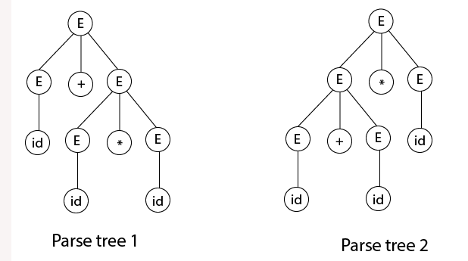
Contd…
As there are two different parse tree for deriving the same string "id + id * id", the given grammar is ambiguous.

Slide 8
Removing ambiguity
Rewriting the grammar
For the Expression Grammar, use the following steps to get unambiguous grammar
Take care of precedence (Use a different non terminal for each precedence level and also start with the lowest precedence (PLUS)
Ensure associativity (define the rule as left recursive if the operator is left associative and as right recursive if the operator is right associative )
The equivalent unambiguous grammar
E → E + T
E → T
T → T * F
T → F
F → id
It reflects the fact that ∗ has higher precedence than +.
Also that, the operators + and ∗ are left-associative as these 2 are left recursive rules.

Slide 9
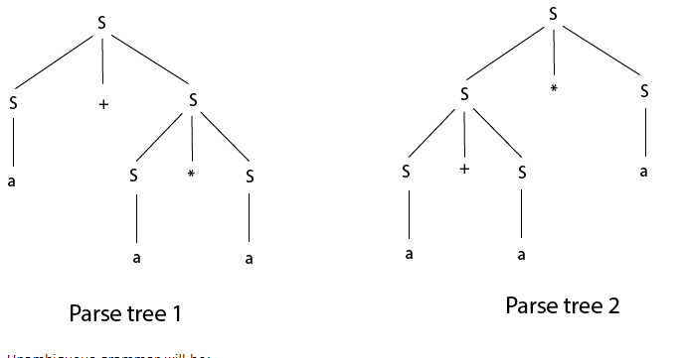
Contd…
Example2:
Check that the given grammar is ambiguous or not. Also, find an equivalent unambiguous grammar.
S → S + S
S → S * S
S → S ^ S
S → a
Solution:
Let us derive the string “a + a * a"

Slide 10
Contd…
The equivalent unambiguous grammar
S → S + A | A
A → A * B | B
B → C ^ B | C
C → a
It reflects the fact that ^ has higher precedence than * and +.
The operators + and ∗ are left-associative as these 2 are left recursive rules.
The operators ^ is right associative as it is right recursive rule.

